Slide 1
European integration of medical education. Roles of evaluation and acreditation
J. Palés
Facultad de Medicina Universidad de Barcelona

Slide 2
Introduction of comparable degrees
Two cycles system
Uniform system credits
Learning outcomes-based
Student and staff mobility
Long life learning
International collaboration in quality assurance and curriculum development
EHEA
Bologna Process
European High
Education Area

Slide 3
WHAT HAVE BEEN THE EFFECTS OF THE BOLOGNA PROCESS ON SPANISH MEDICAL EDUCATION?
Changes in Undergraduate Medical Education Structure
Changes in Medical Schools Curricula
Development of Mechanisms for Quality Assurance

Slide 4
Structure of Medical Education in Spain
INTEGRATED DEGREE BACHELOR-MASTER (6 YEARS) 360 ECTS
(Ministry of Education)
According Bologna Process
PH D STUDIES
(Ministry of Education)
According Bologna Process
SPECIALIST TRAINING
Ministry of Health
CONTINOUS MEDICAL EDUCATION
Professional Bodies

Slide 5
Medical Schools
Have defined learning outcomes according to different models (Institute for International Medical Education, IIME)
Have modified their curricular structures
Have modified or must modify learning and assessment methods

Slide 6
In Quality Assurance: What has been done in Spain ?
A national Quality Agency (ANECA) was created on July, 2002 by agreement of the Council of Ministers.
ANECA is a full member of ENQA (European Association for Quality Assurance in Higher Education) 2004.
ANECA has been consolidating its technical and institutional role within the framework of Spain’s integration into the EHEA.

Slide 7
The purpose of ANECA is to improve the quality of our higher education system by way of evaluation, certification and accreditation. Their goals are:
To enhance the improvement of university teaching, research and management activities.
To foster Universities performance monitoring following objective and transparent processes.
To provide public administrations with appropriate information for decision-making within the scope of their authority.
To provide society with information about the achievement of Universities aims.

Slide 8
Undergraduate and Postgraduate Medical Education (Bachelor, Master and PH D Degrees) Accreditation by ANECA
The Accreditation mechanism is not specific for Medical Education. Non specific criteria for different degrees (for example the same criteria for Medicine and Law)
It is common to all Degrees in Spanish Universities
Process has two steps: VERIFICATION and ACCREDITATION.
Before to implement any Degree in any Spanish University, ANECA must verify it.
Different commissions (Health Sciences Commission)

Slide 9
Universities decide to implement a degree (Bachelor/Master)
Ask to the Universities
How will you design it?
Universities present a proposal

Slide 10
Verification process: ANECA approves the proposals of Universities , checking that any degree to be implemented by an University meets the legal requirements established by the Government’s regulations
Description of the general characteristics of the Degree
Justification of the need of the Degree (according to social needs)
Description of learning outcomes to acquire by students
Admission process according to national laws
Teaching planning
Academic Staff (number and expertise)
Resources and services (material resources for teaching)
Expected Results
System for quality assurance
Mobility system
Realistic implementation schedule

Slide 11
After 6 years of implementation (Medicine)
INSTITUTIONAL EVALUATION BY ANECA
(through institution self diagnosis + external evaluation including ON-SITE VISIT
What have you done?
ACCREDITATION (yes or not)
Notes:
11

Slide 12
Accreditation of programmes

Slide 13
The evaluation of academic degrees and institutions in ANECA
The procedure
Self-evaluation
Site-Visit by experts panel
Evaluation for Accreditation

Slide 14
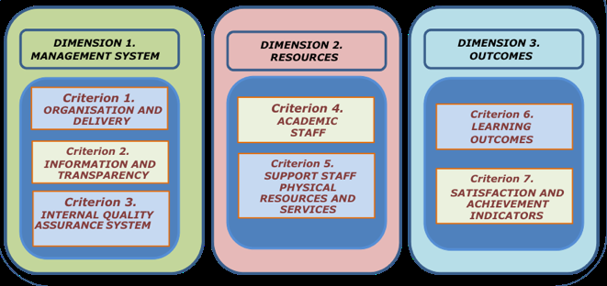
ACCREDITATION OF PROGRAMS
Assessment Framework for expost programme accreditation:
Site visit required!
Is the programme being implemented according to the project proposal commitment?
Do the achieved results justify the renewal of the accreditation of the programme?

Slide 15
The evaluation of academic degrees and institutions in ANECA
Assessment for European/International Labels
Goal: INTERNATIONALIZATION! To offer, within some disciplines, the possibility to obtain an international label simultaneously with the compulsory process for ex-post national accreditation.
Currently in place in TWO disciplines
Engineering
Informatics

Slide 16
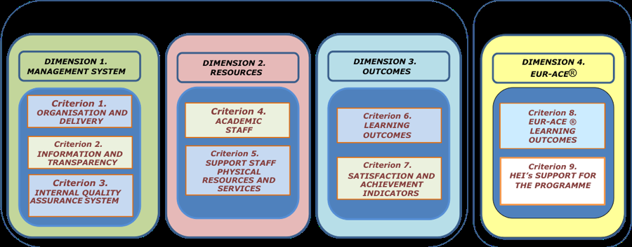
The evaluation of academic degrees and institutions in ANECA
Assessment Framework for expost programme accreditation+EUR-ACE Label:
Site visit required!
Common to the compulsory national accreditation
Additional information for the label

Slide 17
The evaluation of academic degrees and institutions in ANECA
Labels under the umbrella of
ENAEE European Network for the Accreditation of Engineering Education
EAEVE
European Association of Establishments for Veterinary Education
WFME World Federation for Medical Education
EQANIE
ECTN
AACSB
Association to Advance Collegiate Schools of Business
European Association of Establishments for Veterinary Education (EAEVE) in co- operation with the Federation of Veterinarians of Europe (FVE).
leading international system of quality assessment, improvement, and accreditation of higher education institutions in management and business administration
Regional offices in Africa, The Americas, Eastern Mediterranean, Europe, South East Asia, Western Pacidfic
European funded project to jolint European accreditation standards and a qualification framework for accreditation of informatics / computer-science education
More than 200 chemical societies and HE EEurope
All European Engineering Accreditation Agencies + FEANI, SEFI, CESAER, EUROCADRE S etc.

Slide 18
The current compulsory accreditation process of the programmes can provide information about the 60-70% of the WFME standards
If one medical school decides to apply for the certification of its IQAS via AUDIT programme, information about the 80% of WFME standards could be obtained

Slide 19
What have been the positive consequences of the Bologna process?
Implementation of the culture of quality assurance in Spanish Universities. Universities have implemented mechanisms of quality assurance.
Universities have planned its degrees in a exhaustive form
An important effort has been done by the Universities in terms of transparency, coherence and organization.

Slide 20
What have been the negative side effects?
No justified grow of the number of Medical Schools in Spain (in last 6 years from 27 to 39, more of them private medical schools) and 4 more are expected.
Great increase (50%) of new medical students in the last 6 years.
The Quality Agency cannot decided about the creation of new medical schools. It only can approve or deny the implementation of the Degree.
Have the new medical schools minimal quality standards? Until now, ANECA has only evaluated proposals. It will be necessary to wait the end of the current accreditation process.
Notes:
20

Slide 21
Which are the outstanding issues?
Implementation of really outcome-based medical curricula.
More adequate definition of learning outcomes
Real introduction of transversal competencies along the curriculum
Improvement of Learning outcomes assessment
Notes:
21

Slide 22
Thank you for your attention
Gracias por su atención
jpales@ub.edu
Notes:
22

