Slide 1
Palace, Workshop or Network? - the World Federation for Medical Education
David Gordon
WFME
Ferney-Voltaire, France

Slide 2
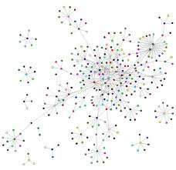
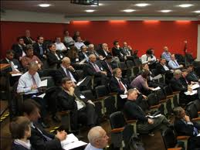
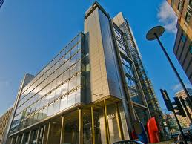
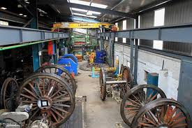

Slide 3
Background and history
The idea (1966) coming from WHO, the World Medical Association, and medical educators
Established 1972 – WHO, WMA, regional associations for medical education

Slide 4
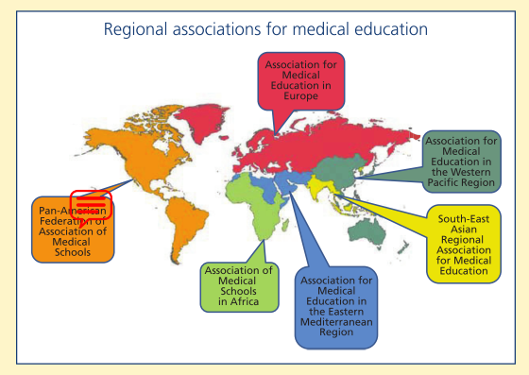

Slide 5
Now also involves
- closely –
IFMSA (students)
ECFMG
- also –
UNESCO
CenMEDIC (Centre for Medical Education in Context)
AMSE
others

Slide 6
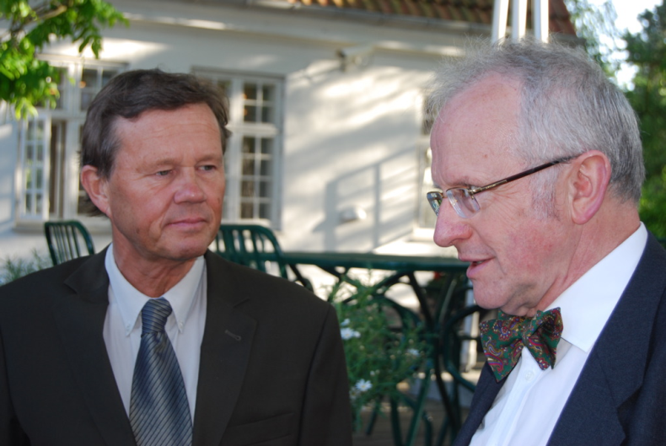
Bureaucracy
Executive committee
Members in all categories (regions, WHO, WMA, IFMSA, ECFMG etc)
President (~100%) (+ past-president and vice-president)
Administration (one full-time, two part-time
Treasurer (part time)
Many advisers

Slide 7
No glass and marble palace…..
One large room in Ferney, one tiny room in Copenhagen
Dozens of phone calls and emails from around the world, every day
(USA, Edinburgh, Copenhagen, Ferney-Voltaire)

Slide 8
What does it do?
How does a workshop and network organisation work? – last 15 years
Standards for medical education
Accreditation
Essential databases
The future role of the doctor

